Slide 1
COMP 2230
Week 5 - Friday

Slide 2
Last time
Induction examples
Strong induction

Slide 3
Questions?

Slide 4
Assignment 2

Slide 5
Logical warmup
A monk begins an ascent of Mt. Fuji on Monday morning, reaching the summit by nightfall.
He spends the night at the summit and starts down the mountain on the same path the following morning, reaching the bottom by dusk on Tuesday.
Show that at some precise time of day, the monk was at exactly the same spot on the path on Tuesday as he was on Monday.

Slide 6
Recursion
In order to understand recursion, you must first understand recursion.

Slide 7
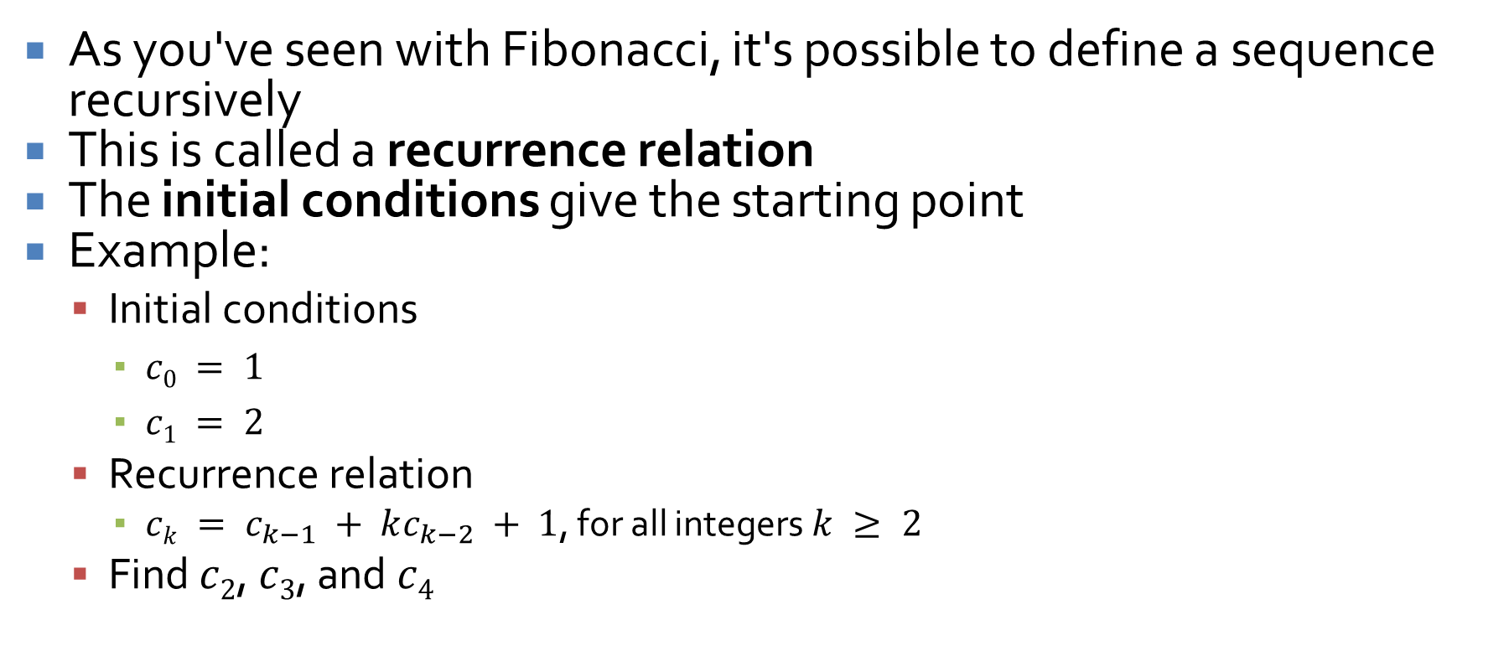
Recursively defined sequences
As you've seen with Fibonacci, it's possible to define a sequence recursively
This is called a recurrence relation
The initial conditions give the starting point
Example:
Initial conditions
$c0 = 1$
$c1 = 2$
Recurrence relation
$ck = c_{k−1} + kc_{k−2} + 1$, for all integers $k ≥ 2$
Find $c2$, $c3$, and $c4$

Slide 8
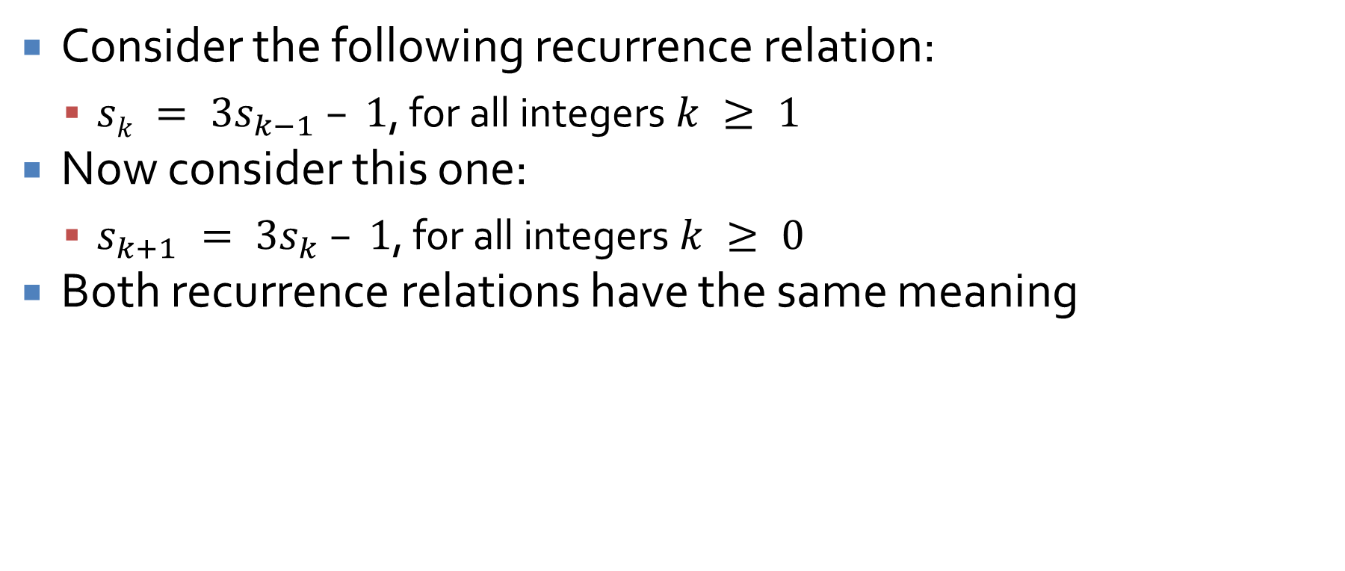
Writing recurrence relations in multiple ways
Consider the following recurrence relation:
$sk = 3s_{k−1} – 1$, for all integers $k ≥ 1$
Now consider this one:
$s_{k+1} = 3s_{k} – 1$, for all integers $k ≥ 0$
Both recurrence relations have the same meaning

Slide 9
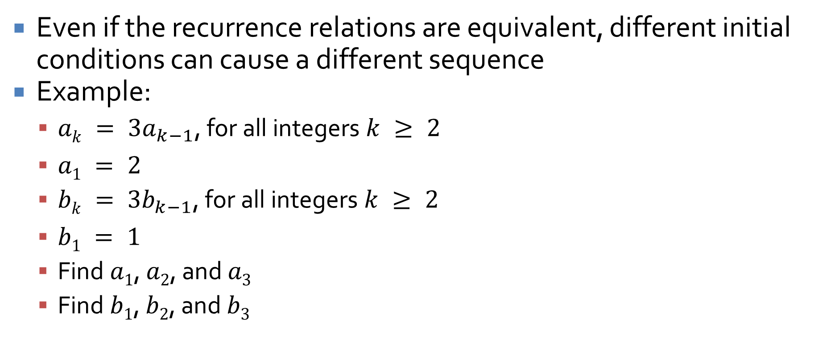
Differences in initial conditions
Even if the recurrence relations are equivalent, different initial conditions can cause a different sequence
Example:
$ak = 3a_{k−1}$, for all integers $k ≥ 2$
$a1 = 2$
$bk = 3b_{k−1}$, for all integers $k ≥ 2$
$b1 = 1$
Find $a1$, $a2$, and $a3$
Find $b1$, $b2$, and $b3$

Slide 10
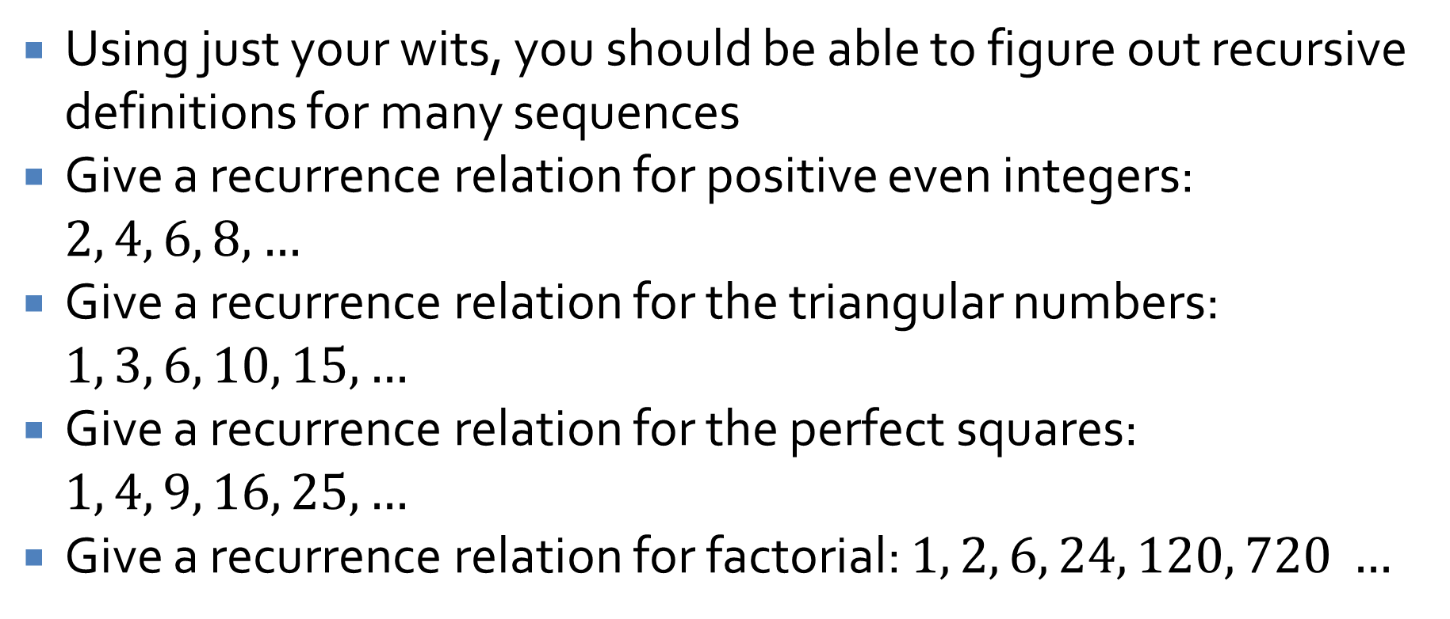
Practice
Using just your wits, you should be able to figure out recursive definitions for many sequences
Give a recurrence relation for positive even integers: $2, 4, 6, 8, …$
Give a recurrence relation for the triangular numbers: $1, 3, 6, 10, 15, …$
Give a recurrence relation for the perfect squares: $1, 4, 9, 16, 25, …$
Give a recurrence relation for factorial: $1, 2, 6, 24, 120, 720 …$

Slide 11
The proof is on fire
Perhaps you believe that you have the correct recurrence relation for perfect squares
Can you prove it?
Hint: Use mathematical induction
Recursion and induction and two sides of the same coin
The right cross and the left jab, if you will, of the computer scientist's arsenal

Slide 12
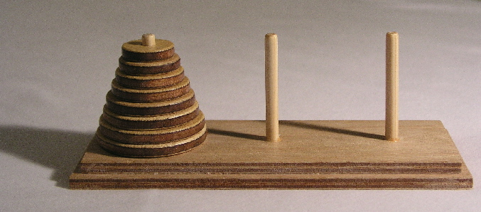
Tower of Hanoi
Imagine that you have a tower of disks such that each is smaller than the one it rests on
Rules:
There are 3 pegs, and all the disks are on peg 1
No two disks are the same size
A larger disk may not be placed on a smaller disk
Disks can only be moved one at a time
Move all the disks to peg 3

Slide 13
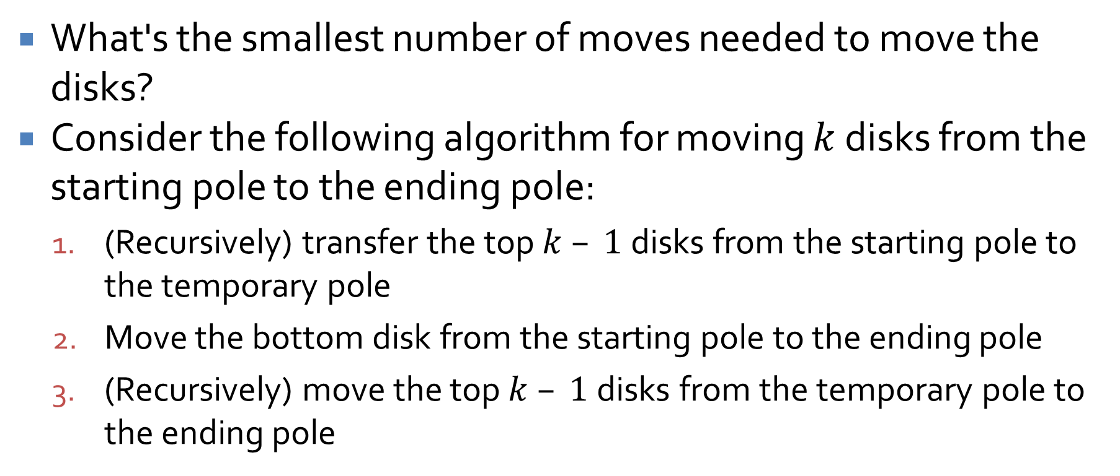
Power of Hanoi
What's the smallest number of moves needed to move the disks?
Consider the following algorithm for moving $k$ disks from the starting pole to the ending pole:
(Recursively) transfer the top $k – 1$disks from the starting pole to the temporary pole
Move the bottom disk from the starting pole to the ending pole
(Recursively) move the top $k – 1$disks from the temporary pole to the ending pole

Slide 14
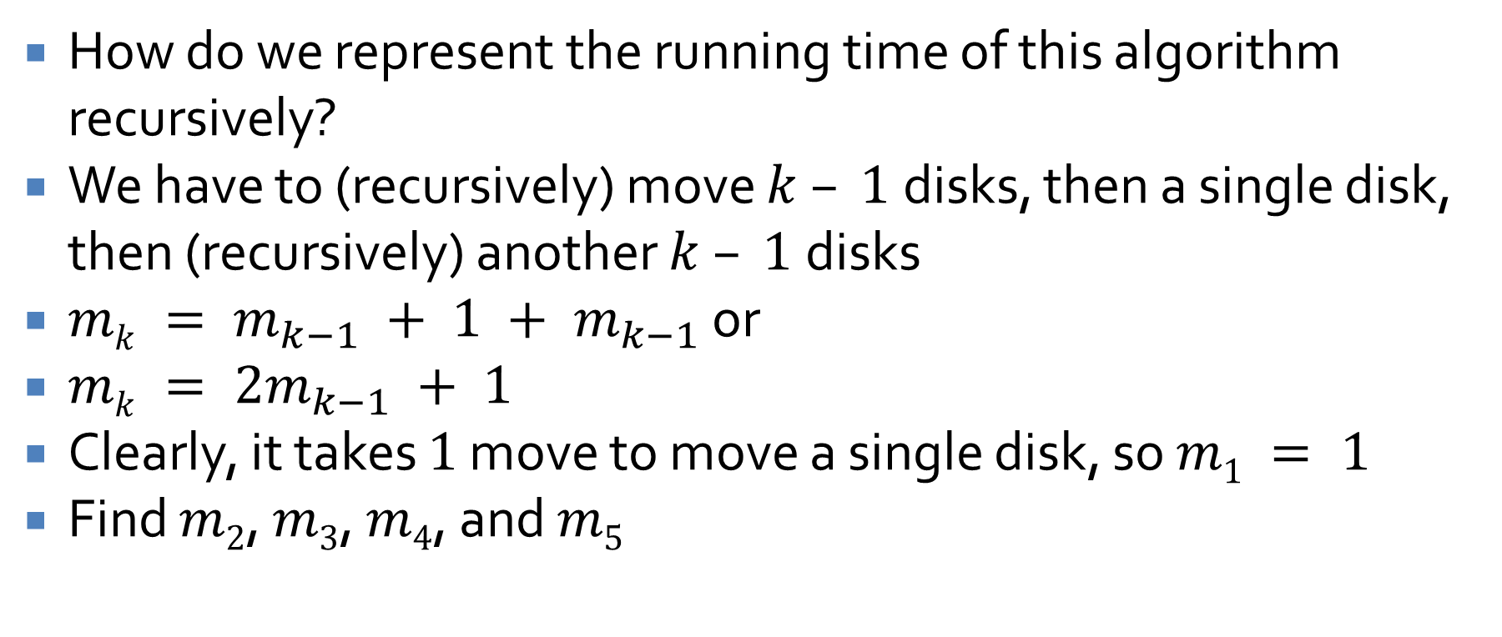
Tower of annoy
How do we represent the running time of this algorithm recursively?
We have to (recursively) move $k – 1$disks, then a single disk, then (recursively) another $k – 1$disks
$mk = m_{k−1} + 1 + m_{k−1}$ or
$mk = 2m_{k−1} + 1$
Clearly, it takes $1$ move to move a single disk, so $m1 = 1$
Find $m2$, $m3$, $m4$, and $m5$

Slide 15
Fibonacci
We all know and love Fibonacci by now
Recall that it is supposed to model rabbit populations
For the first month of their lives, they cannot reproduce
After that, they reproduce every single month

Slide 16
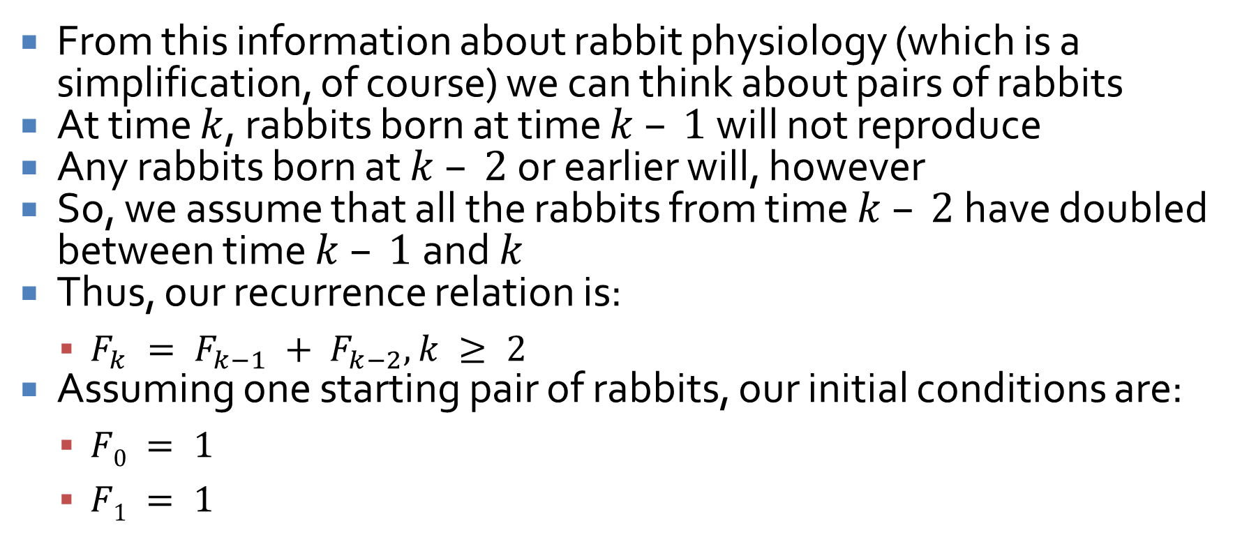
Fibonacci rules
From this information about rabbit physiology (which is a simplification, of course) we can think about pairs of rabbits
At time $k$, rabbits born at time $k – 1$ will not reproduce
Any rabbits born at $k – 2$or earlier will, however
So, we assume that all the rabbits from time $k – 2$ have doubled between time $k – 1$and $k$
Thus, our recurrence relation is:
$F_{k} = F_{k−1} + F_{k−2}, k ≥ 2$
Assuming one starting pair of rabbits, our initial conditions are:
$F0 = 1$
$F1 = 1$

Slide 17
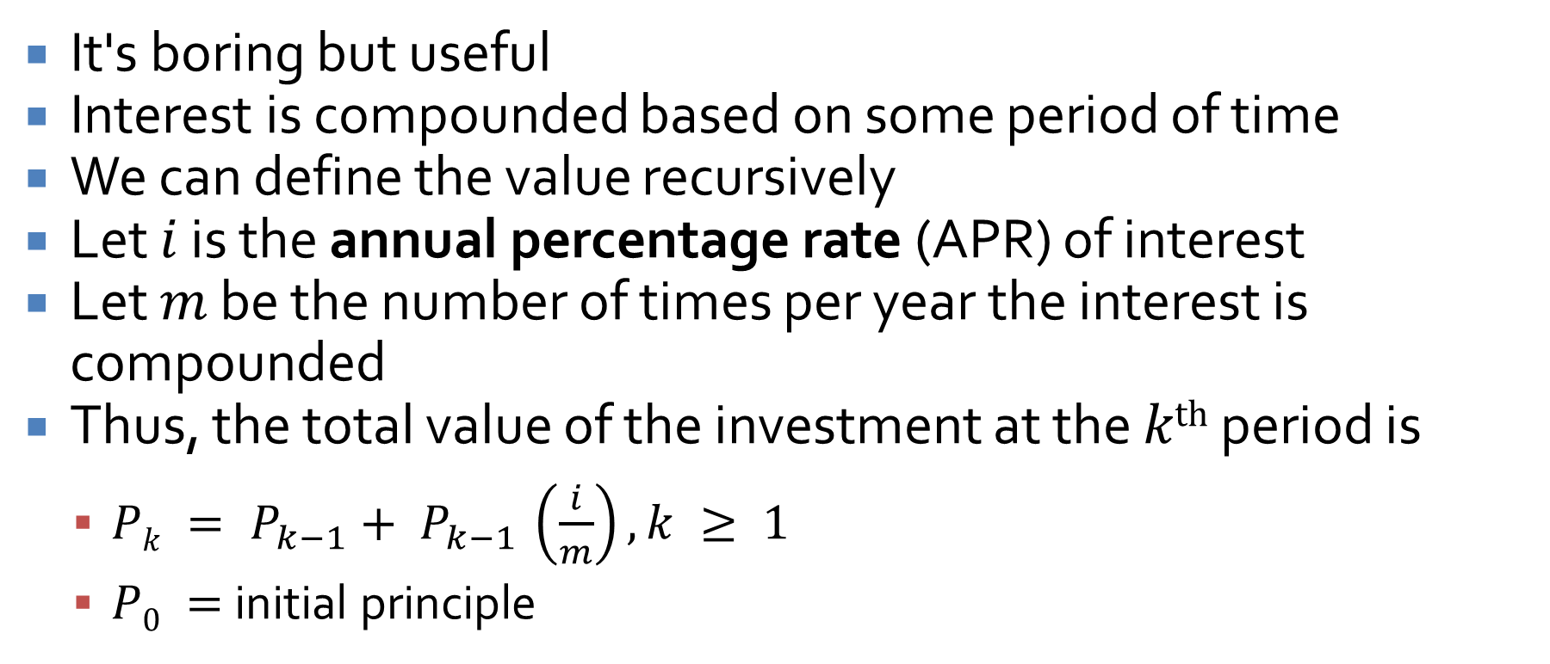
Compound interest
It's boring but useful
Interest is compounded based on some period of time
We can define the value recursively
Let $i$ is the annual percentage rate (APR) of interest
Let $m$ be the number of times per year the interest is compounded
Thus, the total value of the investment at the $kth$ period is
$Pk = P_{k−1}+ P_{k−1} \left(\frac{i}{m}\right), k ≥ 1$
$P0 =$initial principle

Slide 18
Solving Recurrence Relations

Slide 19
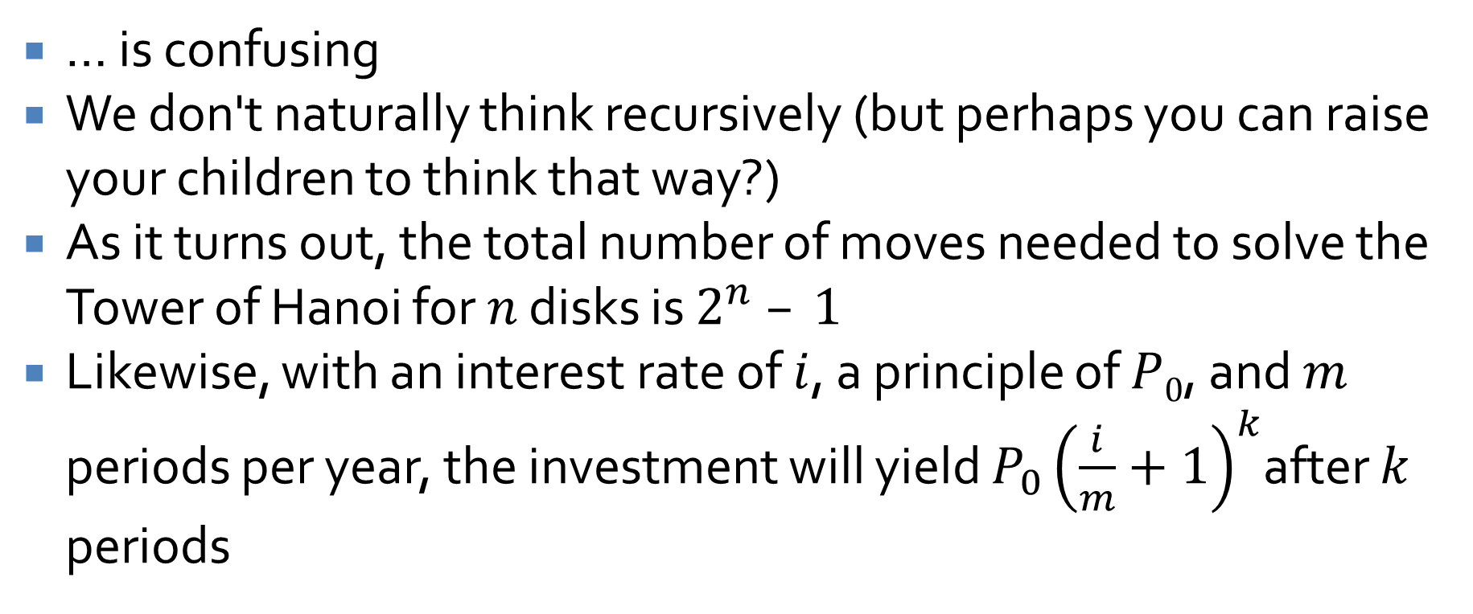
Recursion
… is confusing
We don't naturally think recursively (but perhaps you can raise your children to think that way?)
As it turns out, the total number of moves needed to solve the Tower of Hanoi for $n$ disks is $2^{n} – 1$
Likewise, with an interest rate of $i$, a principle of $P0$, and $m$ periods per year, the investment will yield $P_{0}{\left(\frac{i}{m}+1\right)}^{k}$after $k$ periods

Slide 20
Finding explicit formulas by iteration
Consequently, we want to be able to turn recurrence relations into explicit formulas whenever possible
Often, the simplest way is to find these formulas by iteration
The technique of iteration relies on writing out many expansions of the recursive sequence and looking for patterns
That's it

Slide 21
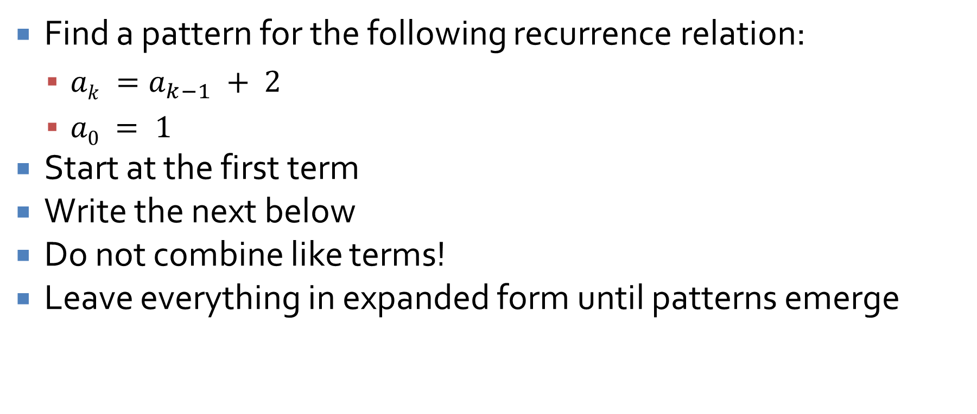
Iteration example
Find a pattern for the following recurrence relation:
$ak =a_{k−1} + 2$
$a0 = 1$
Start at the first term
Write the next below
Do not combine like terms!
Leave everything in expanded form until patterns emerge

Slide 22
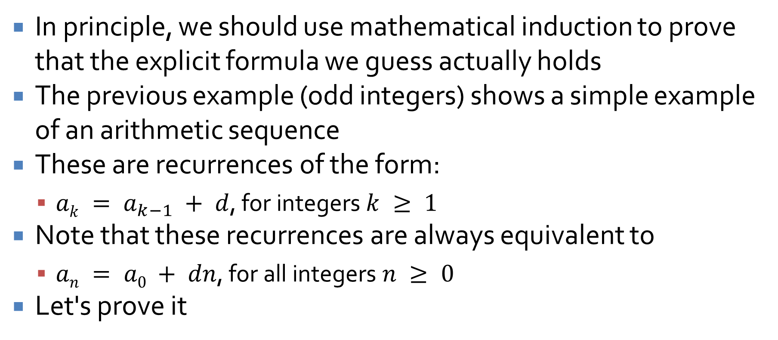
Arithmetic sequence
In principle, we should use mathematical induction to prove that the explicit formula we guess actually holds
The previous example (odd integers) shows a simple example of an arithmetic sequence
These are recurrences of the form:
$ak = a_{k−1} + d$, for integers $k ≥ 1$
Note that these recurrences are always equivalent to
$an = a0 + dn$, for all integers $n ≥ 0$
Let's prove it

Slide 23

Geometric sequence
Find a pattern for the following recurrence relation:
$ak = ra_{k−1}, k ≥ 1$
$a0 = a$
Again, start at the first term
Write the next below
Do not combine like terms!
Leave everything in expanded form until patterns emerge

Slide 24
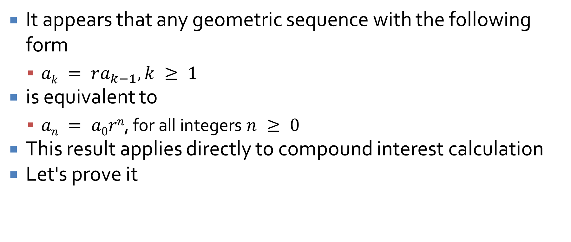
Geometric sequence
It appears that any geometric sequence with the following form
$ak = ra_{k−1}, k ≥ 1$
is equivalent to
$an = a0rn$, for all integers $n ≥ 0$
This result applies directly to compound interest calculation
Let's prove it

Slide 25
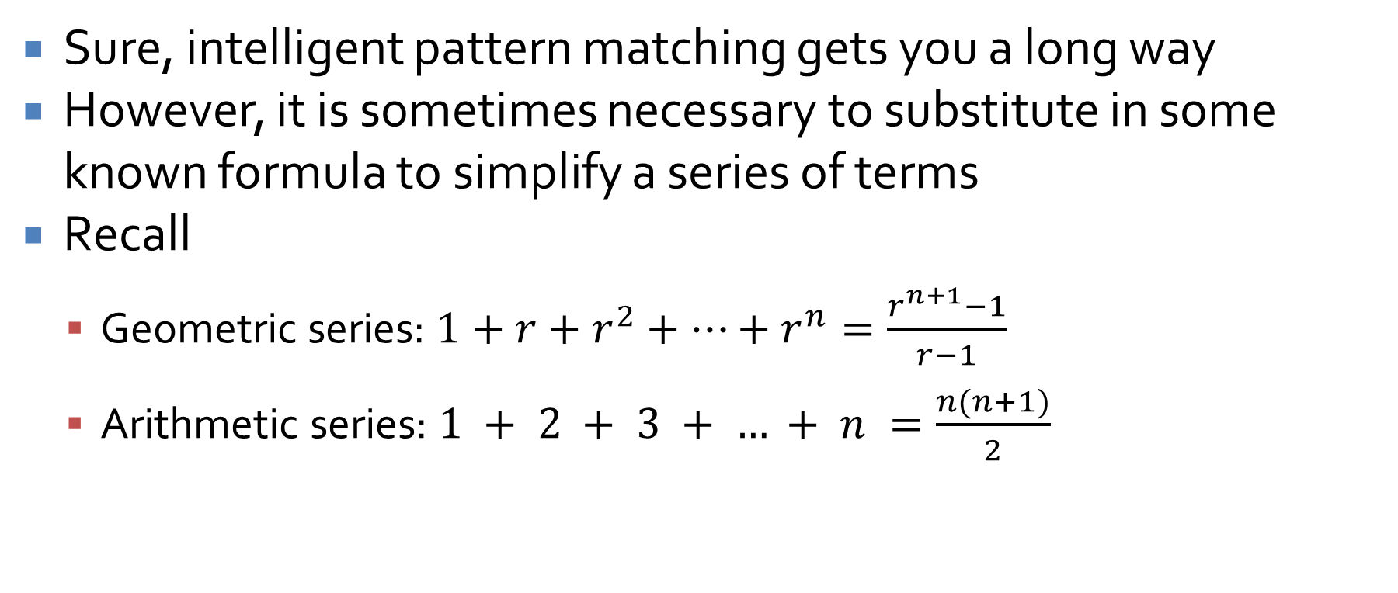
Employing outside formulas
Sure, intelligent pattern matching gets you a long way
However, it is sometimes necessary to substitute in some known formula to simplify a series of terms
Recall
Geometric series: $1+r+r^{2}+…+r^{n}=\frac{r^{n+1}−1}{r−1}$
Arithmetic series: $1 + 2 + 3 + … + n =\frac{n(n+1)}{2}$

Slide 26
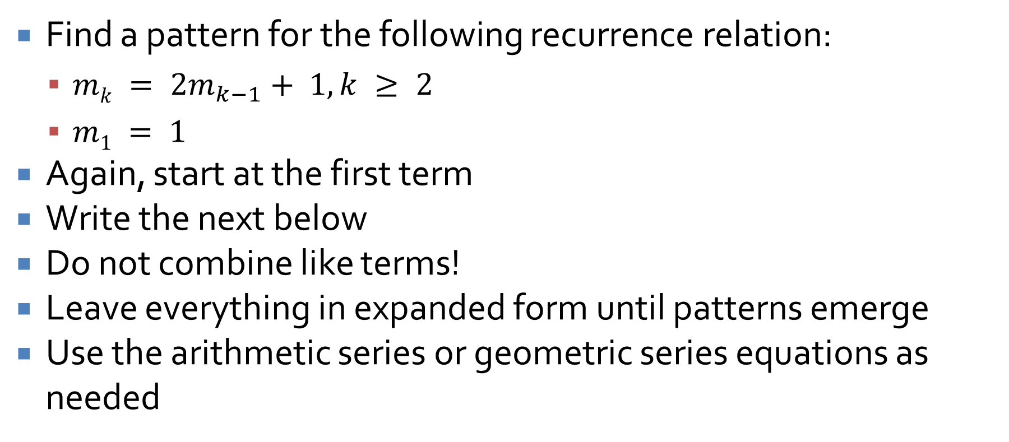
Tower of Hanoi solution
Find a pattern for the following recurrence relation:
$mk = 2m_{k−1}+ 1, k ≥ 2$
$m1 = 1$
Again, start at the first term
Write the next below
Do not combine like terms!
Leave everything in expanded form until patterns emerge
Use the arithmetic series or geometric series equations as needed

Slide 27
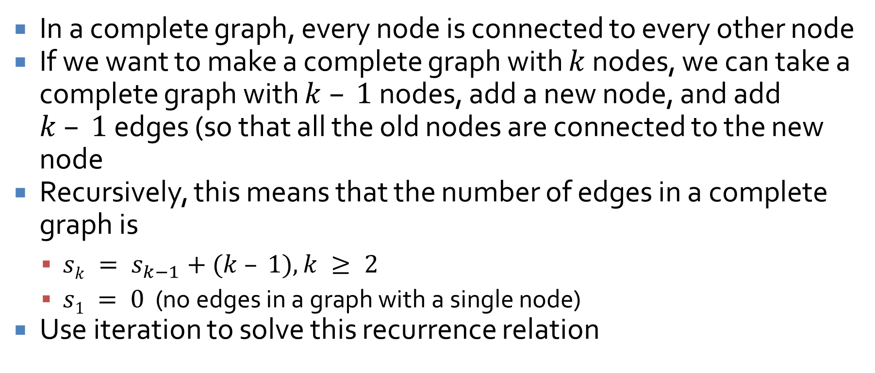
How many edges are in a complete graph?
In a complete graph, every node is connected to every other node
If we want to make a complete graph with $k$ nodes, we can take a complete graph with $k – 1$nodes, add a new node, and add $k – 1$edges (so that all the old nodes are connected to the new node
Recursively, this means that the number of edges in a complete graph is
$sk = s_{k−1}+(k – 1), k ≥ 2$
$s1 = 0$ (no edges in a graph with a single node)
Use iteration to solve this recurrence relation

Slide 28
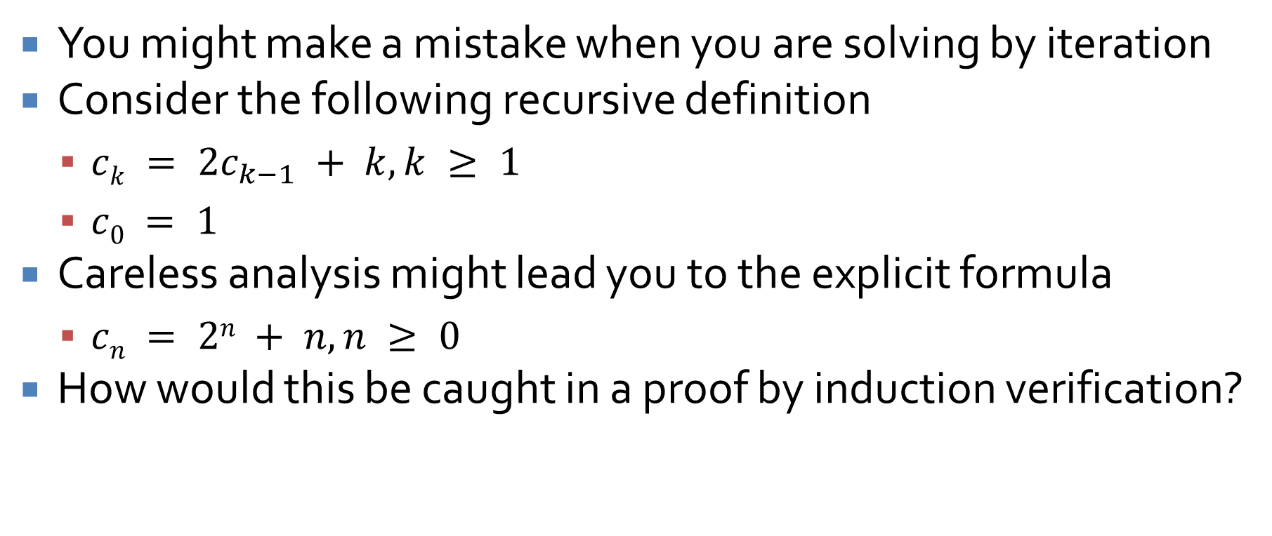
Mistakes were made!
You might make a mistake when you are solving by iteration
Consider the following recursive definition
$ck = 2c_{k−1} + k, k ≥ 1$
$c0 = 1$
Careless analysis might lead you to the explicit formula
$cn = 2n + n, n ≥ 0$
How would this be caught in a proof by induction verification?

Slide 29
Solving Second-Order Linear Homogeneous Relations with Constant Coefficients

Slide 30
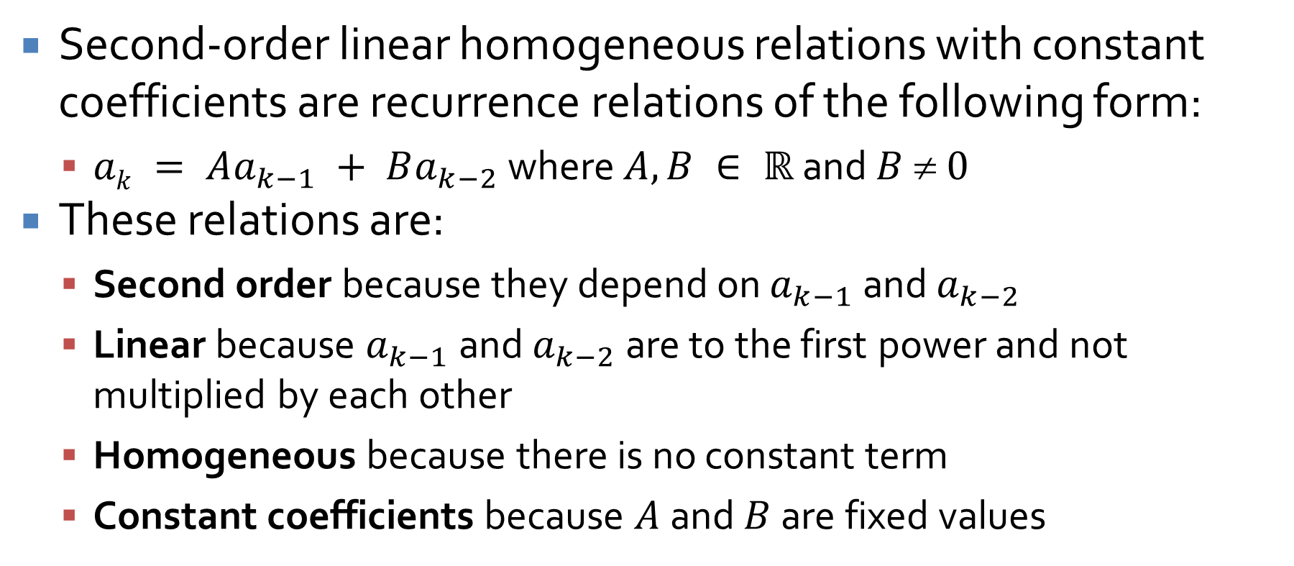
Second-Order Linear Homogeneous Relations with Constant Coefficients
Second-order linear homogeneous relations with constant coefficients are recurrence relations of the following form:
$ak = Aa_{k−1} + Ba_{k−2}$ where $A, B ∈ ℝ$ and $B  0$
These relations are:
Second order because they depend on $a_{k−1}$ and $a_{k−2}$
Linear because $a_{k−1}$ and $a_{k−2}$ are to the first power and not multiplied by each other
Homogeneous because there is no constant term
Constant coefficients because $A$ and $B$ are fixed values

Slide 31
Why do we care?
I'm sure you're thinking that this is an awfully narrow class of recurrence relations to have special rules for
It's true: There are many (infinitely many) ways to formulate a recurrence relation
Some have explicit formulas
Some do not have closed explicit formulas
We care about this one partly for two reasons
We can solve it
It lets us get an explicit formula for Fibonacci!

Slide 32
Upcoming

Slide 33
Next time…
Finish second order linear homogeneous recurrence relations with constant coefficients
General recursion
Review of set theory
Definitions
Properties of sets

Slide 34
Reminders
Finish Assignment 2
Due Monday
Read 6.1 and 6.2

